Slide 1

Leveraging Customer Data and Look Like ...
Concepts, Code and Consequences
Nashville Analytics Summit

Slide 2
Agenda
Concepts:
Code:
Consequences:
Rock Star:

Slide 3
The Complexity of Customer Analytics
Silos/Structure of organization can lead inconsistencies of data
Data Science methods or application of customer data not always understood by company personnel and they fall back to old habits
Existing and potential customers need different levels of service (high touch vs. mass market) so your customer journey not the same
Managing customer process(s) should be core competency and the best process in your organization
Notes:
the customer’s world & data is never static - look at it from a CMO perspective

Slide 4
The Complexity of Customer Analytics
Many number of data sources and the variety of types of data
CRMs / POS /Financial & Credit Systems/Eligibility / Website /Clinical /SMS
/IOT (Vending) / Market Research, Crowd sourced (Yelp) /Transportation etc.
Velocity / Volume / Variety + Validation

Slide 5
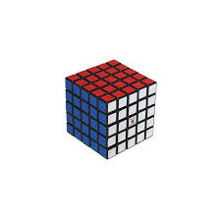
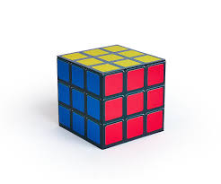
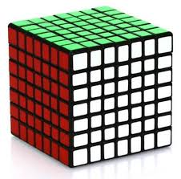
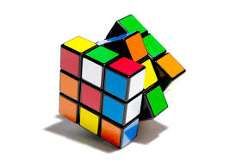
The Complexity of Customer Analytics
Notes:
So many facets to customers and their evolution and your relationship with your business.
Change they will – So how do you monitor this change?

Slide 6

Case Study
Scenario
You are the new Chief Marketing (CMO) at “Nashville SaaS company”
Revitalize this organization and improve profitability
How do you attack the problem and look like a … ?
Notes:
Where do your start?
What tools do you use?
Whose information do you trust?
What is success and how do you define?

Slide 7
Agenda
Concepts:
Code:
Consequences:
Rock Star:

Slide 8
Strategies for Leveraging Customer Data
Perfect an automated data pipeline to facilitate self-service abilities.
Be an “Insights Machine” from the data that you know.
Know particular customer(s) in-depth (behaviors/habits/thinking).
Know what you don’t know…
Be a “Rock Star” at one or many stages of the life cycle process.
“Look around the corner” … envision what you should doing and make it happen.
Notes:
Pt 1:Perfect an automated data pipeline to clean, manage and store data in an easy to consume manner for Marketing self-service abilities.

Slide 9
Customer and Business Concepts
Customer Journey / Life Cycle
Market Segmentation
Net Promoter Score
Customer Retention and Churn
Customer Lifetime Value

Slide 10

Customer Journey
Notes:
Data follows the process.

Slide 11
Customer Life Cycle:
Customer’s Journey => (Value / Experience /Problem Resolution)
Market Research
& Evaluation
Purchase
Evaluation
Re- purchase?
Customer Loss
Customer
Data
Surveys
Comparisons
Price(s)
Trials
Referrals
Retail
Online
FB Mkt
3rd Party
Resolution
Return
Value
Survey
Quantity
Timing
Other Vendors/
Channels
New Vendor
New Solution
Financial change
Job completed
Customer Life Cycle => (Understanding / Optimization / Advantage)
Market Analysis
& Segmentation
Acquisition
Optimize
Retention
Post-Mortem
Customer
Processes
You need tools, processes and analytics for each stage of the customer life cycle
Notes:
B>C e.g. Painting new fence to protect it.
B>B e.g. Software purchase.
Wholistic perspective and IT and Marketing working together.

Slide 12


Customer Definition & Data
Your business (model) and definition of customer often determines your data source(s).
Definition also the quality/timing of your customer data
Anticipate data quality challenges and how to resolve them prior to any statistical analysis
Define revenue, cashflow, returns/warranties
Data + Discipline => P(Damn Good Results)
Notes:
@KSC, timing of receipt of data was somewhat problematic with bi-yearly adjustments - Healthcare Payors with CMS have retroactivity for payments for eligibility true-ups ( Medicare vs. Medicaid)
Pt3: Size will affect sample sizing and the validation of test and validation data sets to perfect model.
Loyalty data – what is your definition of loyalty (days /months/ years ) ? This is a business rule definition, really!

Slide 13
Sources of Customer Data vs Quality of Data
“squishy” - biased
Interviews
Focus Groups
Surveys
Social Media
Websites
Experiments (A/B testing)
E-mail/Direct Marketing
POS Data
CRMs & Databases
“structured” – less biased ?
Notes:
Being that data can be so malleable, the sources of where you pull your data from to construct your analytics are as important as much as the type of the source as well.
Of these sources, which one is most important to the company and CMO?

Slide 14

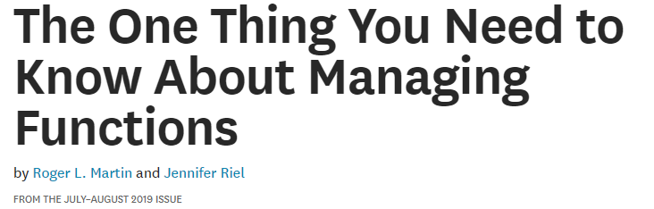
Customer Research Question(s)?
How do you drive alignment between Executive Team / Marketing and IT-Data Science Teams?
Where will we play?
How will we win?
Notes:
The type and quality of your data is important to your E-Team. – What are they trying to do with this data?
If your going to be a Rock Star if you can help E-Team solve these 2 important questions.
“Leaders must identify their primary customers inside the firm, the core offering of the function to these customers(which should be closely related to the firm’s competitive advantage), and what part of that offering will be outsourced and what part delivered by the function itself).
See you as a resource to the business. Understand where the business is coming from?
Roger Martin

Slide 15
Market and Customer Analysis Tools
Market Analysis
Focus is on Market (aggregate level) to assess the competitive posture in market place
Identify Customer Needs
Value Proposition (Uniqueness in the market)
Customer Lifetime Value “CLV”
Branding & Loyalty
Product Launch/Sunset
Customer Analysis
Focus is at the customer level to assess how to best reach customers
Customer Preferences
Operational/Managerial Segmentation
RFM Analyses
4 Ps of Marketing
Customer Satisfaction / Engagement
Notes:
Business vs Technology Tools
4Ps of Marketing:
Product (Creation/Extensions)
Price (Elasticity of Customers)
Promotion (Best way to get the word out)
Place (Channel Strategy)
Question is…. Who is doing the market analysis and what are the quantitative and qualitative results?
Likewise on the customer analysis…. That would be y’all.

Slide 16
Market Analysis Tools and Focus
Market Analysis Tools | Strategic / Tactical | Qualitative / Quantitative
Value Proposition | S | Both
Market Segmentation | T | Quantitative
Identify Customer Needs | S/T | Both
Customer Lifetime Value “CLV” | S/T | Quantitative
Branding & Loyalty | S | Qualitative
Product Launch/Sunset | S/T | Both
Notes:
Accountability?

Slide 17
Customer Analysis Tools and Focus
Customer Analysis Tools | Strategic / Tactical ? | Qualitative / Quantitative?
Customer Preferences | T | Both
Operational Segmentation | T | Quantitative
4 P Analysis | T | Both
Customer Satisfaction | S/T | Quantitative
Customer Engagement | T | Quantitative
Notes:
Accountability?

Slide 18
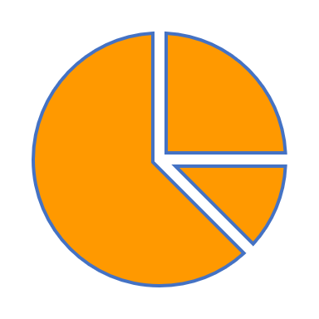
Market Segmentation
Notes:
A means of dividing up your customer (existing/potential) base into sub-groups, known as segments based on some shared characteristics. Usually based on needs, lifestyle, demographics or psychographics or buying behavior.
From DS perspective you want to prove that the differences between and among sub-group are statistically material allowing you further downstream marketing activities.

Slide 19
The Benefits of Market Segmentation
Indicate where sources of revenue or profit may lie.
Focuses on actual customer behavior.
Identify consumers’ values, attitudes, and beliefs as they may be potentially receptive to specifically to product or service offerings/brand.
Anticipate changes in markets or customer behavior.
Identifying the benefits and features that matter to your customers.
Source: Rediscovering Market Segmentation
https://hbr.org/2006/02/rediscovering-market-segmentation

Slide 20
Strategic Segmentation Approaches
Levels of profitability by… (channel, pricing, etc.)
Rank/Degree of Customer Lifetime Value “CLV”
Scoring by “NPS” ranking
Buying behavior – usage, loyalty, price elasticity
Organization size / Industry size /Geography
Notes:
By using these concepts the data will be apparent from utilizing these tools

Slide 21
Market Segmentation Thoughts…
More of art (trial and error) than science but … similar in the data science process that it is iterative in nature and over time.
Actual purchase behavior is much stronger criteria than values and preferences and provide predictive power.
Segments will evolve due to market dynamics and must be performed on a frequent basis based on your company’s eco-system.
Obtaining insights are fruitless if you don’t have the operational capabilities to harvest them.
Should provide “strategic” insights and require you to adapt your operational processes to take advantage of them.
Notes:
The Biggest mistake is to do it once and think you have it figured out.
This tool should be used with other tools and like customer retention to provide a continuous amount of customer feedback.

Slide 22
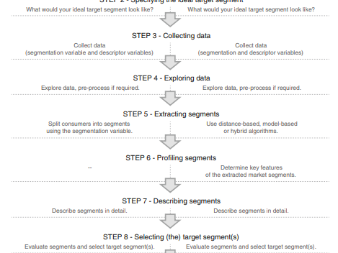
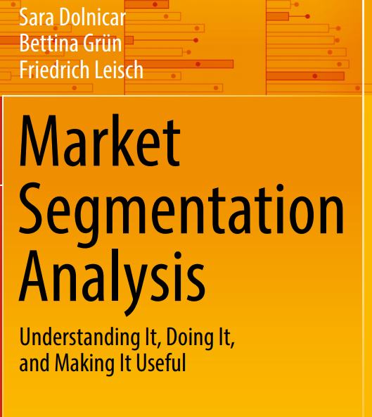
Market Segmentation
MSA package
http://www.marketsegmentationanalysis.org/

Slide 23
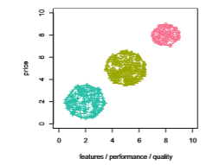
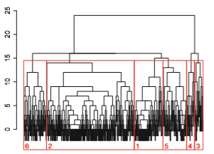
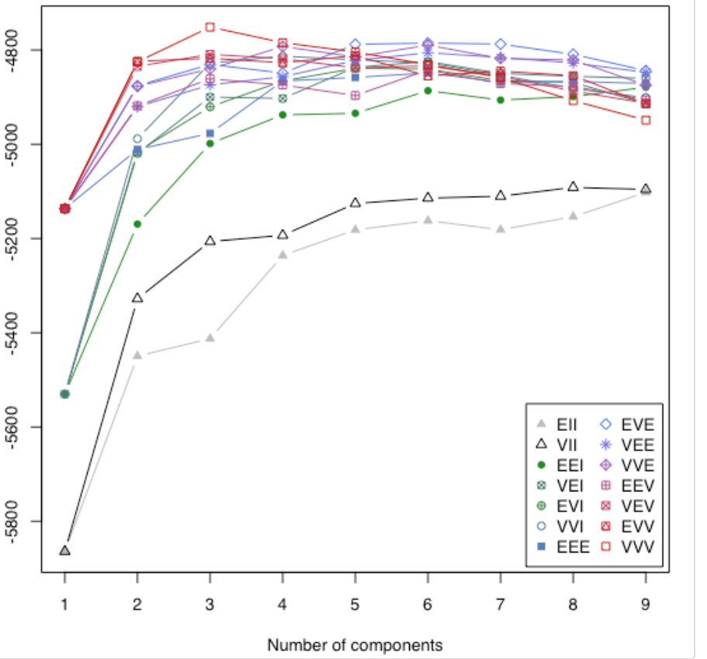
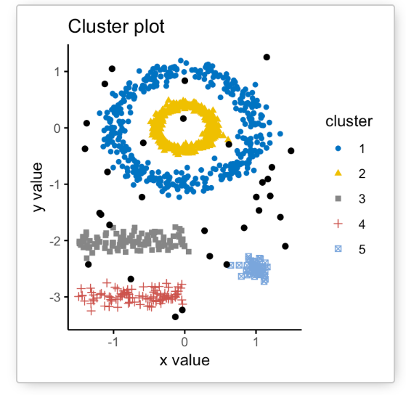
Types of Clustering
Partitioning / K-Means Clustering
Hierarchical Clustering
Model-Based Clustering
Advanced/Hybrid Clustering

Slide 24

Market Segmentation and Customer Insights?
Notes:
Market segmentation forces organizations to take stock of where they stand, and where they want to be in future.
When implemented well, market segmentation also leads to tangible benefits, including a better understanding of differences between consumers, which improves the match of organizational strengths and consumer needs.
=> Allows you the potential to dominate a niche; where there is a great match between the organization and customer in terms of their needs, are large enough to be profitable, have solid potential for growth, and still small enough not to be interesting to competitors. But you must be able to know you customers.
MS is the first step in knowing you customers and gaining the insights you need to go forward.

Slide 25
Sources of Customer Data Leading to Customer Insights
How to Attract Attention
Interviews
Focus Groups
Surveys / Reviews
Social Media
Websites
Experiments (A/B testing)
E-mail/Direct Marketing
POS Data
CRMs & Databases
Uncover motives
How Customers Search
Notes:
Challenge for the business/marketing is the volume of data keeps increasing in a magnitude and factors. (Not number of rows/columns)- TBs

Slide 26
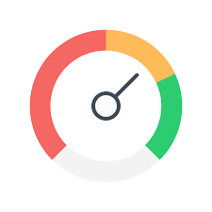
Net Promoter Score
Notes:
Developed by Fred Reichheld from Bain & Company.

Slide 27
Net Promoter Score
Management system determining your customers’ loyalty score.
Obtained via survey by asking a recommendation question which allows you to obtain a numeric score
Each individual score is between 0-10.
The overall NPS score is calculated by subtracting the percentage of Detractors from your Promoters.
“How likely are you to recommend [us] on scale of 0 to 10?”

Slide 28
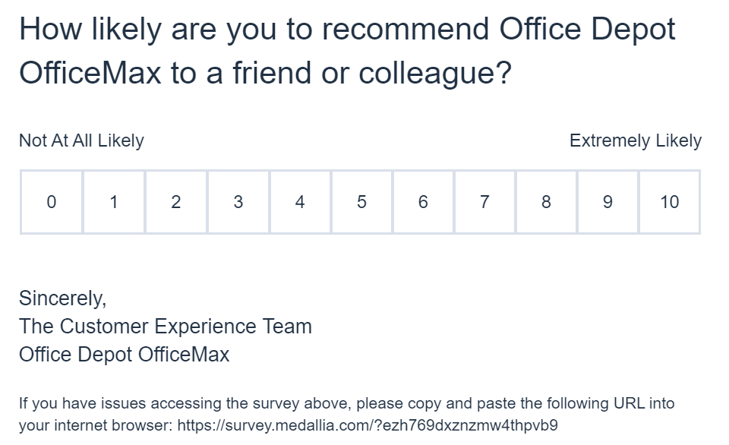
NPS Example

Slide 29
Loyalty metrics package: NPS install from Cran repository

Slide 30

Customer Retention
Notes:
Simple concept and has huge consequences on profitability and valuation.

Slide 31
Customer Retention Thoughts…
Win/loss metrics on sales versus retention metrics
Many analytic tools (Excel to R) and methods to calculate retention.
Needs to be an explicit process on customer retention and accountability on everyone’s part.
Post-Mortem analyzes should occur to derive the insights of loss.
Does your company have a % threshold and perhaps an automated mechanism(s) for interventions.
Notes:
Pt 1: Win/Loss conversations regarding sales should be about margin because the importance it has on CLV.

Slide 32

Customer Lifetime Value

Slide 33
Customer Lifetime Value (“CLV”)
What is this CLV tool ?
How can this help my organization?
What insights can this provide us?
What data is required?

Slide 34


CLV Formula
Margin (Revenue – Costs)
Retention (Customer Churn)
Margin x
Retention Rate
1+ Discount Rate – Retention Rate
Hurdle Rate ( Cost of Borrowing)
Notes:
Margin: Increase more revenues and or decrease acquisition costs.
Hold on to your customers longer – better products/services, service and TLC.
Make your company more stable so your borrowing costs are lessened.

Slide 35
Customer Lifetime Value Tool(Process)
A financial metric used to evaluate the value of a customer over the life of the relationship based on discounted future cash flows.
The metric’s time horizon is long-term (L)
This metric helps to compare acquisition costs to the CLV amount to deicide whether obtaining a new customer is profitable.
Often expressed as a formula
This metric is factual based on net profit versus other metrics which are more subjective.

Slide 36
Customer Lifetime Value Thoughts
The levels of granularity of your data can improve the definition of segments/profiles of customer base but also the granularity of your revenue drivers.
Pricing your subscription model does matter.
Monitor your MRR from existing clients and ensure they are renewing right rate and price.
Don’t guess at churn. It will skew/crater your CLV.
Upsell % vs. Total Revenue (Where the profit is!)
Know your NPS/loyalty numbers by segment and know what drives your scores.
Ensure SG&A costs are reasonable as % Revenue.
Notes:
Pt 2: Pricing your contracts at flat price vs. per users/sites vs. amount of discounts given due to poor operational processes like bad service/ inconsistent uptime, etc. – This also will impact your revenue trends and affect your discount rate.

Slide 37
How can CLV help our Organization?
Segments your markets.
Prioritizes the long-term (financial) value of your customers.
Provides financial rigor and guidance for acquisition campaigns.
Obtains untapped segments/customers.
Serving customers well is more profitable than searching for new ones and loosing hard earned ones.

Slide 38

CLV Insights:
Example 1:
A Home Health company segmented its business customers using CLV.
It highlighted its high-touch segment contributed only marginally to revenue, given additional expenditures to maintain this segment.
Using the CLV values it adjusted accordingly and found low touch clients were far more valuable.
Notes:
So the bottom line here is … the costs of acquisition and operation did not justify the additional costs and did not lead to incremental revenue- So one action will be to revisit the High-touch segment given its competitors are doing well in this segment.

Slide 39



CLV Data – Where do I locate it?
CRM, Billing and Accounting System
Revenues (Any three)
Acquisition costs – (Advertising & Sales Marketing)
[Calculated number] stored in spreadsheet / database / report / R file
[Confidential number] obtained from bank contracts from financial group

Slide 40



CLV: Tying it all together

Slide 41


CLV Strategy
H
Profit
L
Time
H

Slide 42
Agenda
Concepts:
Code:
Consequences:
Rock Star:

Slide 43
Customer Focused R Packages
MSA (Market Segmentation Analysis – Understanding your market)
cluster (grouping customers)
survey (complex survey analysis)
NPS (referral/customer satisfaction analysis, “Net Promoter Score”)
SMCRM (Statistical Methods in Customer Relationship)
conjoint (identifying and ranking customer preferences)
Survival (churn analysis)
Tidytext (sentiment analysis)
PCA (variable significance)
Lm/glm (customer prediction)
Uplift (predicting upselling, cross-selling, retention modeling)
BTYD (customer lifetime value “CLV”)

Slide 44
R packages used with Customer Life Cycle:
Customer Life Cycle => (Understanding / Optimization / Advantage)
Market Analysis
& Segmentation
Acquisition
Optimize
Retention
Post-Mortem
Customer
Processes
conjoint
Uplift
lm/glm
BTYD
Survey
NPS
lm/glm
tidytext
Survival
survminer
SMCRM
BTYD
Survey/NPS
MSA (refine)
MSA
Cluster
PCA
You need tools, processes and analytics for each stage of the customer life cycle
Notes:
B>C e.g. Painting new fence to protect it.
B>B e.g. Software purchase.

Slide 45
Other Useful R packages
rJava package – connect with Sales Force CRM
Find this https://www.r-bloggers.com/r-and-salesforce/
uplift package – predictive modeling for upselling and cross-selling
Find this https://www.analyticbridge.datasciencecentral.com/profiles/blogs/what-are-uplift-models

Slide 46
Case Study
Scenario
You are the new Chief Marketing (CMO) at “Nashville SaaS company”
CEO requests you revitalize this organization and improve profitability and bring your analysis to the executive retreat.
How do you attack the problem and look like a … ?
Notes:
Where do your start?
What tools do you use?
Whose information do you trust?
What is success and how do you define?

Slide 47
Case Study Analysis
Where to start?
MSA & Cluster package – Segment definitions
Survey/NPS package – Loyalty & CSat
Survival package – Retention

Slide 48
Where to Start ? – Key Customer Questions
Are we a low priced high volume or high touch niche player?
What market segments do we play in and what are the drivers in each segment? (clustering)
How many customers that are unhappy? What is our retention rate? (NPS & survival)
Which customers are the most profitable and not-so profitable? (CLV)
Notes:
To prepare for the executive retreat, CEO wanted you to pull together questions and analysis on which way to steer the company?
CEO wants to know the following….

Slide 49
Agenda
Concepts:
Code:
Consequences:
Rock Star:

Slide 50
Consequences… or Else …
Be careful! The data doesn’t lie but….
Its not just ALL about the data – context, timing, assumptions, business rules and type of analysis matters
Interpreting the data and providing insights is key
Accuracy vs. Good Enough – Know your audience
Executives want the punch line. Executive Summary ….
Communicate your results and insights in business terms not “data speak”.
Notes:
Pt2: Not knowing your customers (markets, preferences, behaviors, etc.) can lead to bad decisions.
Pt3: not just generating it, assessing its quality and accuracy, and model precision
Pt4: assumptions, alternatives, explanations, and conclusion in bullet points
Pt 5: – executive summary ( low attention spans)

Slide 51
Rock Star !
Concepts, Code and Consequences
Nashville Analytics Summit

Slide 52
Jay Roy jay.roy@strategiccompliancegroup.com M: 931-919-8767
Concepts, Code and Consequences
Nashville Analytics Summit

